Slide 1
Software Development 3
Design Patterns

Slide 2
Introducing Patterns
Experienced Software designers, working independently, have found similar solutions to recurring problems.
These solutions have proven themselves “in the field” and are now accepted as industry standards.
These solutions are called design patterns.

Slide 3
Introducing Patterns
The goal of patterns is to create documentation to help software designers resolve recurring problems encountered throughout all of software development
A shared language for communicating insight and experience about problems and their solutions

Slide 4
Definition Of A Design Pattern
“Each pattern describes a problem which occurs over and over again in our environment, and then describes the core of the solution to that problem, in such a way that you can use this solution a million times over, without ever doing it the same way twice.” Christopher Alexander
Alexander presented 253 patterns in 35 groups at different levels of abstraction or resolution.

Slide 5
Pattern Origins
The current use of the term "pattern" is derived from the writings of the architect Christopher Alexander in the late 70s
Alexander describes some "timeless" design ideas that can be applied to architecture in any decade.

Slide 6
Pattern Origins
In 1987, Ward Cunningham and Kent Beck were working with Smalltalk and designing user interfaces
Decided to use some of Alexander's ideas to develop a small five pattern language for guiding novice Smalltalk programmers
Presented their results at OOPSLA'87 in Orlando in the paper "Using Pattern Languages for Object-Oriented Programs”

Slide 7
Pattern Origins and GOF (Gang of Four)
Another Software Designer, Jim Coplien began compiling a catalog of C++ idioms (which are one kind of pattern) and later published them as a book in 1991
In 1994, four authors Erich Gamma, Richard Helm, Ralph Johnson und John Vlissides published a book titled Design Patterns - Elements of Reusable Object-Oriented Software which initiated the concept of Design Pattern in Software development.
These authors are collectively known as Gang of Four (GOF).

Slide 8
Usage of Design Patterns
Design Patterns have two main usages in software development.
  Common platform for developers
  Best Practices

Slide 9
Common Platform for Developers
Design patterns provide a standard terminology and are specific to particular scenario.
For example, a singleton design pattern signifies use of single object so all developers familiar with single design pattern will make use of single object and they can tell each other that program is following a singleton pattern.

Slide 10
Best Practices
Design patterns have been evolved over a long period of time and they provide best solutions to certain problems faced during software development.
Learning these patterns helps un-experienced developers to learn software design in an easy and faster way.

Slide 11
What is a pattern anyway?
It involves a general description of a recurring solution to a recurring problem replete with various goals and constraints.
It also explains why the solution is needed!

Slide 12
Elements of a Design Pattern
A pattern is made by four elements:
Name
Problem
Solution
Consequences

Slide 13
Name of a Design Pattern
Describe a design problems and its solutions in a word or two
Used to talk about design pattern with our colleagues
Used in the documentation
Increase our design vocabulary

Slide 14
Problem
Describes when to apply the patterns
Explains the problem and its context
Sometimes include a list of conditions that must be met before it makes sense to apply the pattern
Have to occurs over and over again in our environment

Slide 15
Solution
Describes the elements that make up the design, their relationships, responsibilities and collaborations
Does not describe a concrete design or implementation

Slide 16
Consequences
Results and trade-offs of applying the pattern
Helpful for describe design decisions, for evaluating design alternatives
Benefits of applying a pattern
Impacts on a system’s flexibility,extensibility or portability

Slide 17
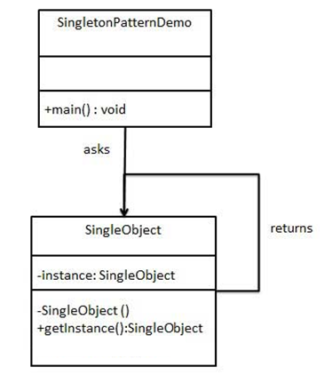
Singleton Pattern
Architecture

Slide 18
Singleton
One of the most widely used design patterns in the Singleton design pattern.
Problem: I want to limit the application to only one
instance of a particular class, but need global
access to that class.
Solution:
Make the constructor private. Then only allow one
instance of the class to be created

Slide 19
Understanding the code…
private static SingletonExample theSingleInstance=null;
The class SingletonExample stores a variable “theSingleInstance”.
There will only ever be one object of type SingletonExample.
The variable “theSingleInstance” stores the object reference to this single instance of SingletonExample.
We will look at static variables later in the course.

Slide 20
Understanding the code…
private SingletonExample(){
System.out.println("Constructor for singleton has been called");
}
This is the constructor for SingletonExample.
It is private which means that other classes can not create instances of SingletonExample.
Only SingletonExample itself can create instances of SingletonExample.

Slide 21
Understanding the code…
Instead of the SingletonTester calling the constructor for SingletonExample as it normally would it calls a method called getInstance().
public static SingletonExample getInstance(){
getInstance() determines if an instance of SingletonExample already exists and it it does not exist it creates it and stores it in the variable theSingleInstance. It then returns the instance.

Slide 22
Understanding the code…
if(theSingleInstance == null){ //doesn’t exist – create it!
System.out.println("The Singleton does not exist so it will be created");
theSingleInstance = new SingletonExample();
return theSingleInstance;
} else{ //exists – return it!
System.out.println("The Singleton does already exist");
return theSingleInstance;
}

Slide 23
Understanding the code…
public static void main(String args[]){
SingletonExample aSingleton = SingletonExample.getInstance();
SingletonExample aSingleton1 = SingletonExample.getInstance();
}
SingletonTester can not create an object of type SingletonExample as the constructor for SingletonExample is private.
Instead the SingletonTester calls the getInstance() method.
In the above example aSingleton and aSingleton1 both have the same value as there is only one instance of SingletonExample

Slide 24
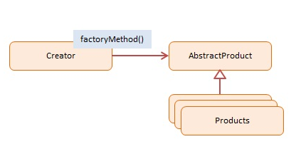
Factory Pattern

Slide 25
Factory
Name: Factory
Problem: We need to have a central location where objects are created and stored
Solution: Don’t allow client classes to create objects. Objects must be created by a central creator class called a factory.
Consequences: A single instance of a factory will be used to create and manage all objects in the system.

Slide 26
Factory
A Factory is a creational pattern.
This pattern helps to model an interface for creating an object.
We call this a Factory Pattern since it is responsible for "Manufacturing" an Object.

Slide 27
Factory Pattern
The calling program in simple factory design pattern typically has a way of telling the factory what it wants
The factory makes the decision which subclass should be returned to the calling program. (likely an if statement)
It then creates an instance of that subclass, and then returns it to the calling program.

Slide 28
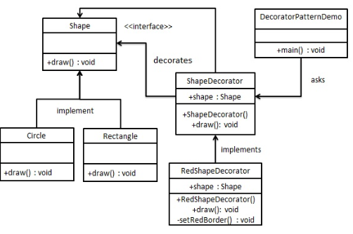
Decorator Pattern

Slide 29
Decorator
The Decorator pattern allows you to add new functionality an existing object without altering its structure.
Problem:
How do you change an object e.g. its appearance without effecting the original object.
Solution:
This pattern creates a decorator class which wraps the original class and provides additional functionality keeping class methods signature intact

Slide 30
Wrapping the object in decoration…
The solution to this class of problems involves encapsulating the original object inside an abstract wrapper interface.
Both the decorator objects and the core object inherit from this abstract interface.
The interface uses recursive composition to allow an unlimited number of decorator "layers" to be added to each core object.

Slide 31
Leave it here….

Slide 32
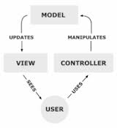
Model View Controller Pattern
Architecture Diagram

Slide 33
Model View Controller (MVC)
Model–View–Controller (MVC) is a design pattern for user-facing software that separates the representation of information from the user's interaction with it.
Problem: I want to be able to update the look and feel of my application without affecting underlying functionality/I want to be able to update underlying functionality without effecting the look and feel
Solution: Split your application into three distinct parts; model view and controller each of which can be replaced without affecting the others:

Slide 34
MVC
The MVC paradigm was introduced by Smalltalk developers at Xerox PARC (Palo Alto Research Center) in the late 1970's. The basic idea is to split your application into three distinct parts, each of which can be replaced without affecting the others:
Model - the data of your application, along with the business logic that defines how to change and access that data. The model can be shared among any number of view and controller objects.

Slide 35
MVC
View - The means of presenting the model's data to the outside world. This could take the form of a GUI, generated speech, audible tones, printouts, or even non-user oriented output, such as turning on an air conditioner.
Controller - The means of gathering user or other environmental input and providing feedback to the model, normally changing some of the data in that model.

Slide 36
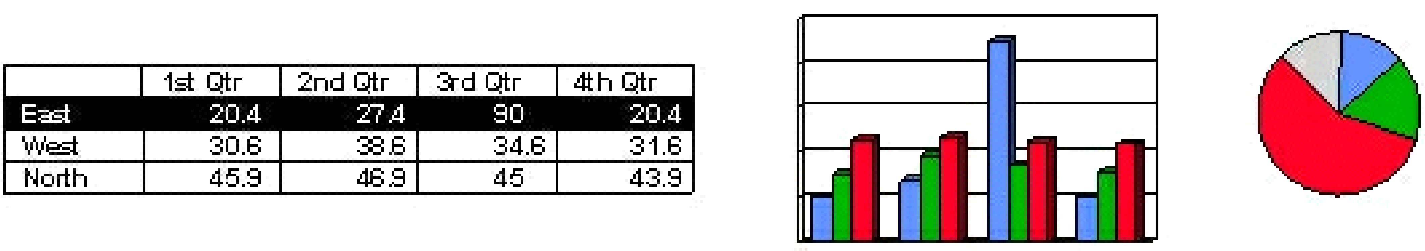
MVC
model:
float sales[3][4];
controller:
views:

Slide 37
MVC….
The view and controller will typically "listen" for changes to the model.
The Java language implements this notification using events.
Whenever the model says "I have changed," the view and controller can ask for the new state of the model's data, then update their presentation to the user.

Slide 38
MVC Tester
The MVCTester creates objects of types Model, View and Controller
It initializes the Controller using both the Model and View object references.
the Model knows nothing about the View and Controller.
the View is unaware of the Model and Controller
The Controller class keeps references to the Model and View classes.
So the Controller sees the Model and View interfaces.
The Controller provides interaction between the Model and View.

